Slide 1
Tree Method to Solve Recurrence Relation
Analysis of Algorithm
Mariha Asad

Slide 2
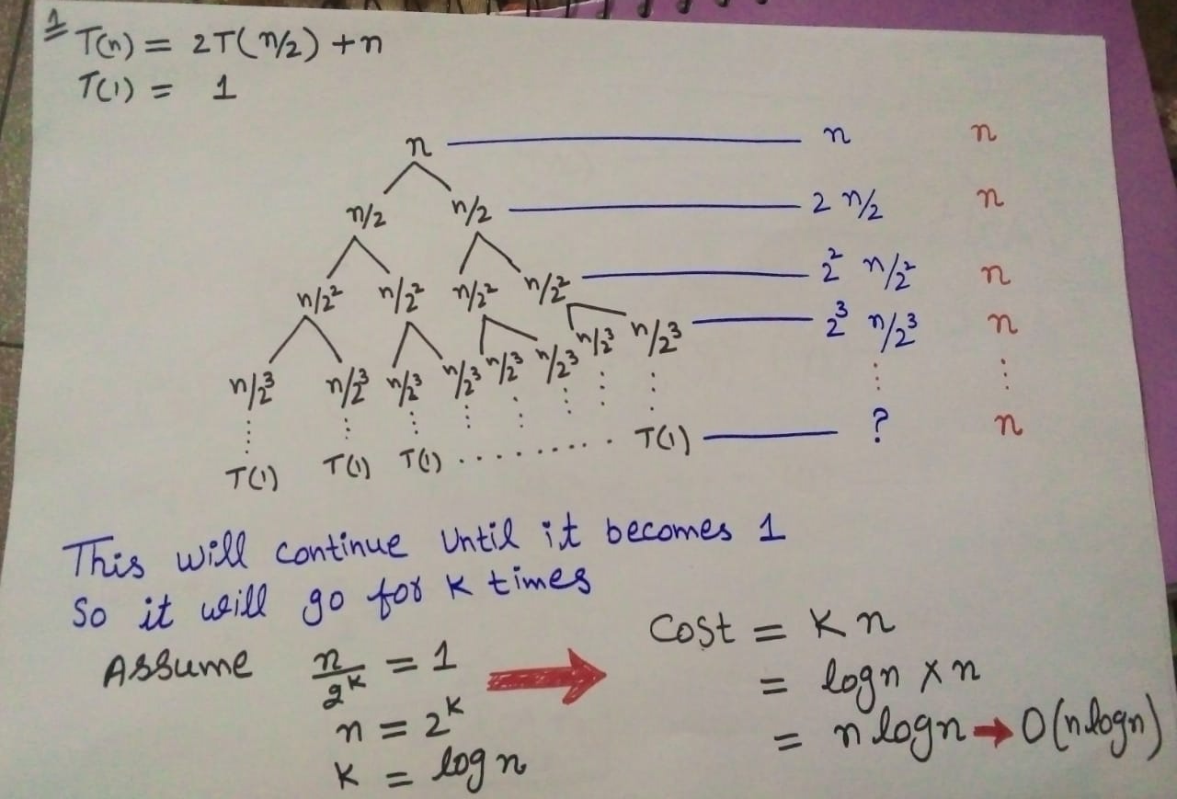
Example 1

Slide 3
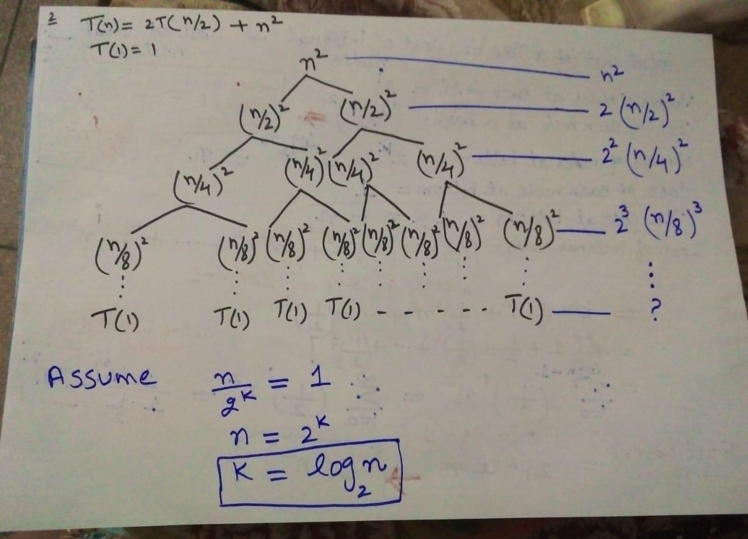
Example 2

Slide 4
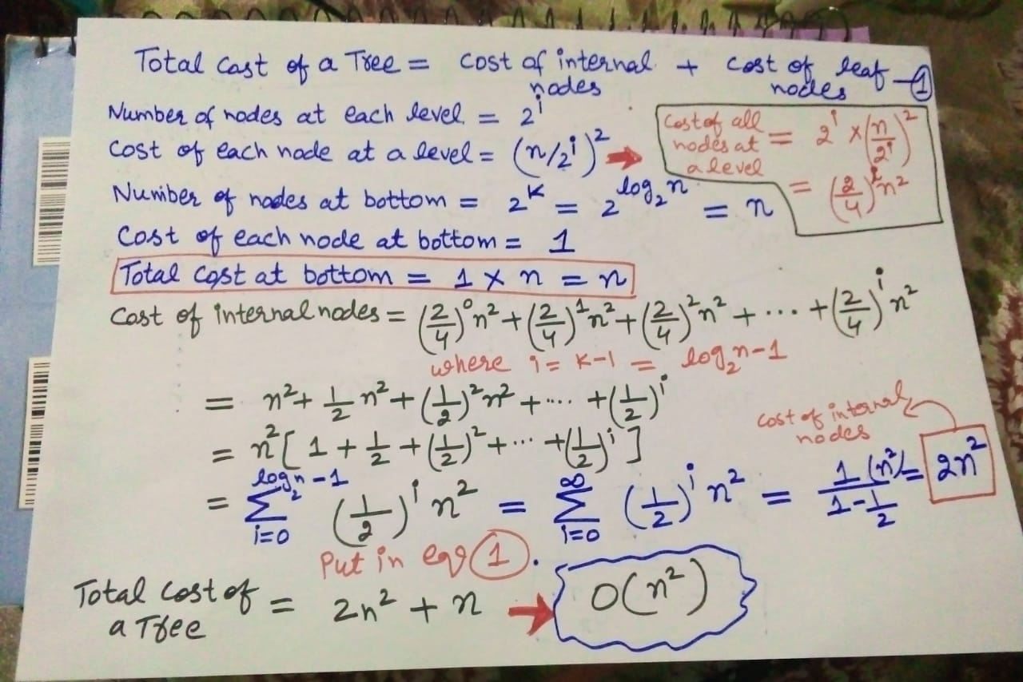
Example 2

Slide 5
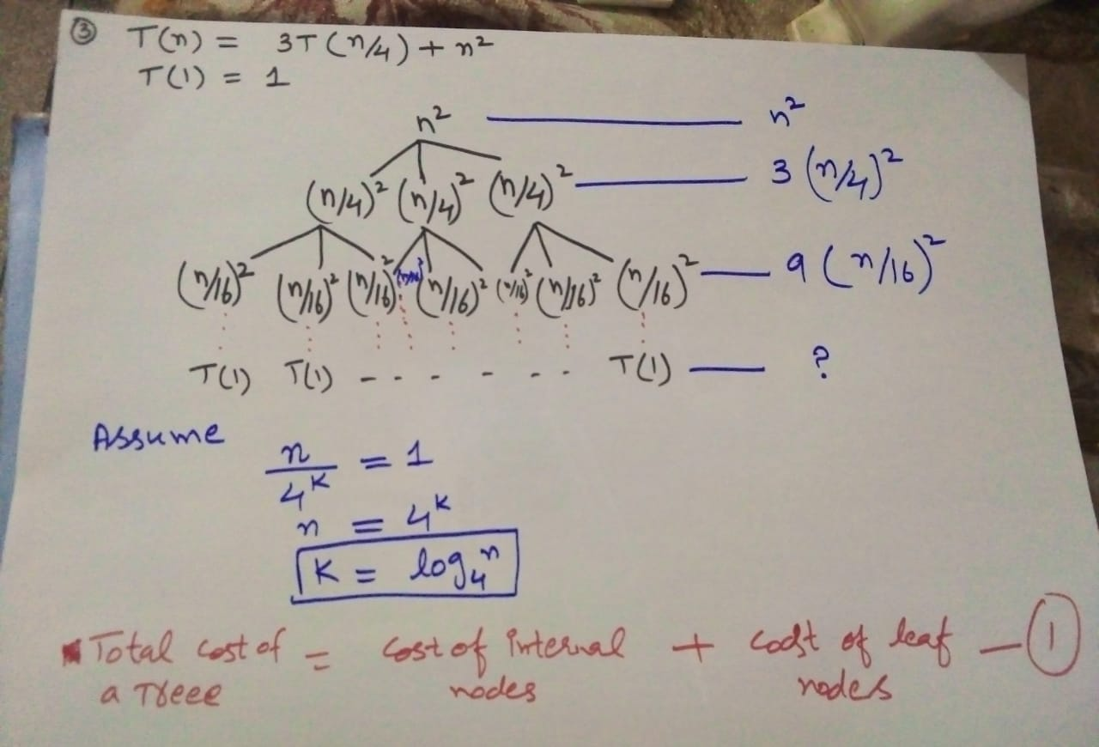
Example 3
T(n) = 3T(n/4) + n²
T(1) = 1

Slide 6
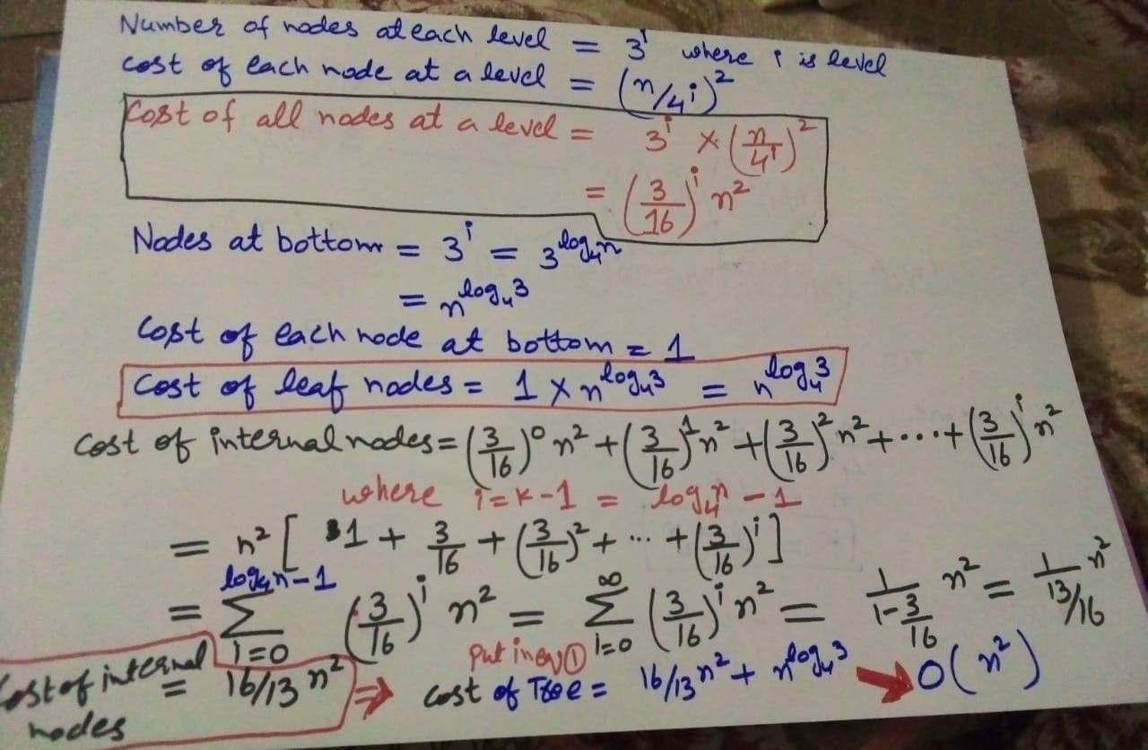

Slide 7
Thanks

